Slide 1


Machine Learning Introduction

Slide 2

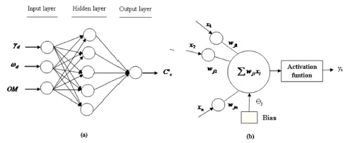
Module 1: Introduction to Machine Learning
The origins of machine learning:-
Computers and machine are invented by human. So how human learns?
Machine learns from data using statistical methods
https://www.educba.com/machine_learning_n_R/

Slide 3
Module 1: Introduction to Machine Learning
The field of study interested in the development of computer algorithms for transforming data into intelligent action is known as machine learning
Available Data
Computing Power
Statistical Method
https://www.educba.com/machine_learning_n_R/

Slide 4
Module 1: Introduction to Machine Learning
Uses and abuses of machine learning
Few use cases -
• Predict the outcomes of elections
• Identify and filter spam messages from e-mail
• Foresee criminal activity
• Automate traffic signals according to road conditions
• Produce financial estimates of storms and natural disasters
• Create auto-piloting planes and auto-driving cars
• Identify individuals with the capacity to donate
• Identification of image whether it is face or not
• Target advertising to specific types of consumers
An abuse cases -
• Examine customer churn
- Check how sensible is your data before it goes live!
https://www.educba.com/machine_learning_n_R/

Slide 5
Module 1: Introduction to Machine Learning
Ethical Consideration:
Caution should be exercised when obtaining or analyzing data in order to avoid
breaking laws, violating terms of service or data use agreements, abusing the trust, or violating privacy of the customers or the public.
Few religion, protected class data is identified as a separate class, "de-identify“
these people by excluding any potentially identifying data in addition to the protected information.
3. Do not disclose PRIVATE aspect of people, Customers or users as PUBLIC ; who may felt exploited.
https://www.educba.com/machine_learning_n_R/

Slide 6
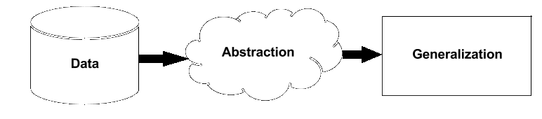
Module 1: Introduction to Machine Learning
Machine learning is the subfield of Computer Science ,that gives computers the ability to learn without being explicitly programmed.
More simplified by Computer Scientist Tom M. Mitchell, says that –
A machine is said to learn if it is able to take experience and utilize it such that its performance improves up on similar experiences in the future.
The basic learning process :- ( it is similar for Machine as well as human being)
• Data input: It utilizes observation, memory storage, and recall to provide a
factual basis for further reasoning.
• Abstraction: It involves the translation of data into broader representations.
• Generalization: It uses abstracted data to form a basis for action.
https://www.educba.com/machine_learning_n_R/

Slide 7
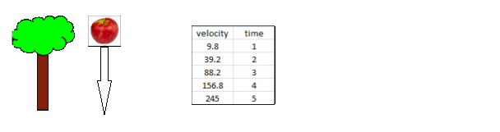
Module 1: Introduction to Machine Learning
How do machine learns?
Abstraction and knowledge representation-
Assigning meaning to data is known as abstraction process.
• Equations • Diagrams such as trees and graphs
• Logical if/else rules • Groupings of data known as clusters
If this meaningful data is represented in either of forms is known as
knowledge representation.
Observation Data Model
g = 9.8 m/s²
https://www.educba.com/machine_learning_n_R/

Slide 8
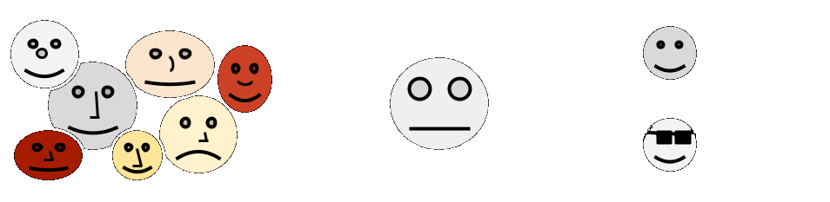
Module 1: Introduction to Machine Learning
Generalization:
The term generalization describes the process of turning abstracted knowledge into a
form that can be utilized for action.
- Once your data model is trained it should be capable of generalize use.
Means it should give proper results irrespective of unknown input values. In terms of
Machine Learning we can say that model should not BIAS, Overfitting or Underfitting.
e.g. A Bias face recognition model…..
Observations Machine’s Understanding Result
Face
Not a FACE
https://www.educba.com/machine_learning_n_R/

Slide 9
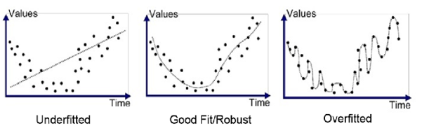
Module 1: Introduction to Machine Learning
3. Assessing the success of learning:
Underfitting:- Not representative the data.
Good Fit/Robust:- Model captures signals in Data. Able to accept minor changes in Future data.
Overfitting:- Try to fit each data point in training data. The future trend may different, and obviously model will fail.
Conclussion:- Model has to be tested on test data. OLS Should be minimum. Model should have good precision and accuracy in ROC Space.
https://www.educba.com/machine_learning_n_R/

Slide 10
Module 1: Introduction to Machine Learning
Steps to apply machine learning to your data:-
Collecting data: Data may be website log, sensor streaming, excel, sql output you have to bring this in our programming environment or import it.
2. Exploring and preparing the data: Most time consuming task, Missing values
imputation, Outlier detector, EDA – Exploratory Data Analysis is for seeing what
the data can tell us beyond the formal modeling or hypothesis testing task.
Training a model on the data: Here data scientist has to select proper
machine learning algorithm to train the model. Try to optimize the model.
Evaluating model performance: Predicting on test data and see how accurate
the model is.
5. Improving model performance: In case model results on test data are not
satisfactory repeat step 3. i.e. again train the model or get more I/P data.
https://www.educba.com/machine_learning_n_R/

Slide 11
Module 1: Introduction to Machine Learning
Choosing a machine learning algorithm:-
The process of choosing a machine learning algorithm involves matching the characteristics of the data to be learned to the biases of the available approaches. Since the choice of a machine learning algorithm is largely dependent upon the type of data you are analyzing and the proposed task at hand, it is often helpful to be thinking about this process while you are gathering, exploring, and cleaning your data.
Thinking about the input data:- Data can not be used as it is. Some features are to be converted for better understanding machine learning algorithm.
Car price Rs. Lakhs | Seating Capacity | Engin Capacity (HP) | Color | Mfg.Year
1.20 | 5 | 1400 | Black | 2011
2.50 | 4 | 1600 | White | 2015
 |  | Convert to new value
 |  |  | …7 | 6
 |  |  | ...1 | 2
 |  |  | Subtract from current year 2017
https://www.educba.com/machine_learning_n_R/

Slide 12
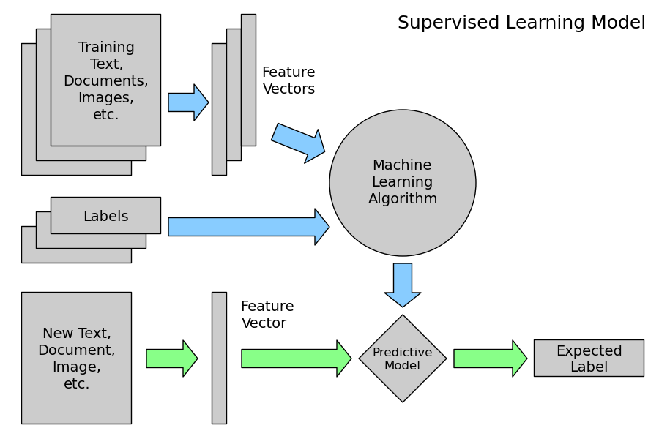
Module 1: Introduction to Machine Learning
Types of Machine Learning Algorithm:- supervised learners that are used to construct predictive models, and unsupervised learners that are used to build descriptive models.
Supervised learning is the type of learning that takes place when the training instances are labelled with the correct result, which gives feedback about how learning is progressing.
https://www.educba.com/machine_learning_n_R/

Slide 13
Module 1: Introduction to Machine Learning
Supervised learning problems are categorized into Regression and Classification problems.
Regression - In a regression problem, we are trying to predict results within a continuous output. meaning that we are trying to map input variables to some continuous function.
Example: Given the data about the size of houses on the real estate market, try to predict their price. Price as a function of size is a continuous output, so this is a regression problem. Algorithm names…
Linear Regression Locally Weighted Regression
Logistic Regression Non-linear Regression
Classification - In a classification problem, we are trying to predict results in a discrete output.
Example: Predicting whether the house "sells for more or less than the asking price", we are classifying the houses based on price into two discrete categories. Algorithm names…
Decision Tree Classifier Naive Bayes Classifier
Random Forests Classifier Hidden Markov Model Classifier
Multi-layer Perceptron K-nearest Neighbours
https://www.educba.com/machine_learning_n_R/

Slide 14
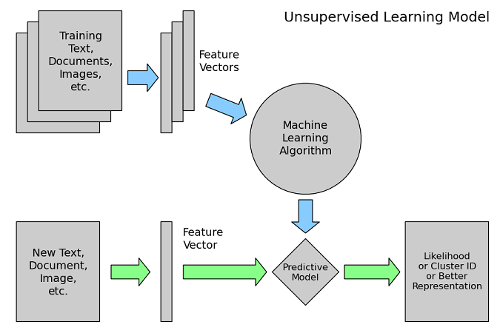
Module 1: Introduction to Machine Learning
In unsupervised learning, the goal is harder because there are no pre-determined categorizations.
Unsupervised learning, on the other hand, allows us to approach problems with little or no idea what our results should look like. We can derive structure from data where we do not necessarily know the effect of the variables
https://www.educba.com/machine_learning_n_R/

Slide 15
Module 1: Introduction to Machine Learning
Unsupervised learning problems are categorized into Clustering and Collaborative filtering problems as described in following sections.
Clustering - Clustering is division of observation into clusters or groups such that all observations within a cluster have some similarity between them.
Canopy Clustering K-means Clustering
Fuzzy K-means Clustering Streaming K-means Clustering
Spectral Clustering Mean Shift Clustering
Correlation Clustering
Collaborative Filtering - Collaborative Filtering (CF) is the process of making automatic predictions about the interests of a user based on his interest/ disinterest similarity with other users.
Example: CF can be used to predict which food item a user would like based on the partial list of his likes and dislikes.
User-based Collaborative Filtering Item-based Collaborative Filtering
https://www.educba.com/machine_learning_n_R/

Slide 16
Module 1: Introduction to Machine Learning
Distributed Machine Learning Tools and Frameworks:-
Many tools and frameworks have come up to help perform ML Techniques on Big Data in a distributed environment. Some of the popular ones have been listed below.
Apache Mahout, Python, Petuum, Jubatus, SAS, MATLAB and R
R:
R is a free software environment for statistical computing and graphics. It has been used extensively for implementing ML algorithms. Packages in R language are available which make it possible to run these ML algorithms in a distributed environment such as Hadoop or H20. For example, when using R with H20, R tells H2O to perform a task, and then H2O returns the result back to R, which is a tiny result, but you never actually transfer the data to R.
https://www.educba.com/machine_learning_n_R/

Slide 17
Module 1: Introduction to Machine Learning
Thanks….
https://www.educba.com/machine_learning_n_R/

Slide 18
Module 1: Introduction to Machine Learning
https://www.educba.com/machine_learning_n_R/

Slide 19
Module 1: Introduction to Machine Learning
https://www.educba.com/machine_learning_n_R/

Slide 20
Module 1: Introduction to Machine Learning
https://www.educba.com/machine_learning_n_R/

